Slide 1

Dream-A-Scene
Christine Talbot, Kenneth Hall,
Yongkang Liu, Grace Christenbery

Slide 2
Introductions
Christine Talbot – System Designer
Kenneth Hall – Interface Designer
Yongkang Liu – Programmer
Grace Christenbery – Programmer
PROJECT NAME:
Dream-A-Scene
¹

Slide 3
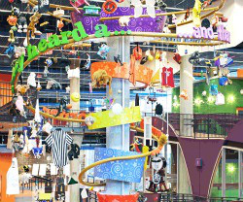
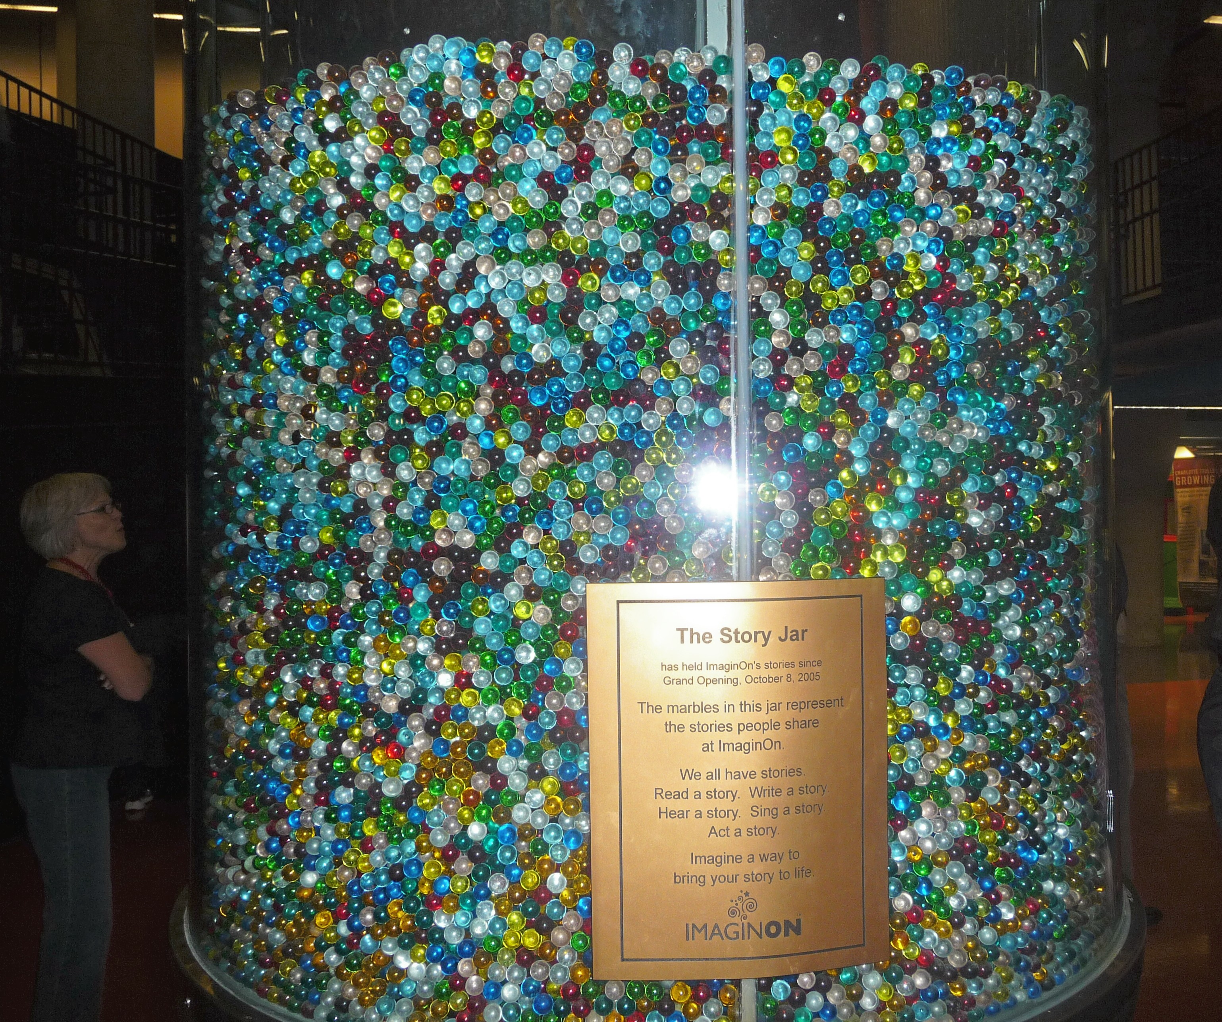
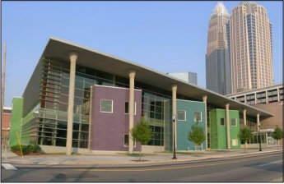
Project Purpose
Microsoft PixelSense Surface
ImgainOn StoryJar Setting
Create Scenes from ClipArt
¹

Slide 4

Key User Groups & Stakeholders
User Groups
Academic Groups
Teachers with Students
Families
Parents with Children
Stakeholders
Museum Administrators
Goals:
Make money from device
Spur more interest in the museum
Application Support
Goals:
Provide an easy interface
Easy to maintain and support
¹

Slide 5
Design Method - Personas
Persona #1
Bullets about who they are
Persona #2
Bullets about who they are
Include a photo of “who” they are on the right--->
¹

Slide 6
Design Method - Observation
Observations of usage of similar collage creators online
Observations of usage with paper prototypes
Observations of usage with soft prototype
¹

Slide 7
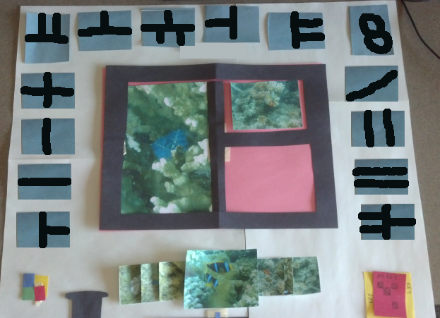
Initial Prototype
Museum Setting
Photo Collages
Concerns:
Too grid-like
Doesn’t encourage
sharing
Ownership of photos
is an issue

Slide 8
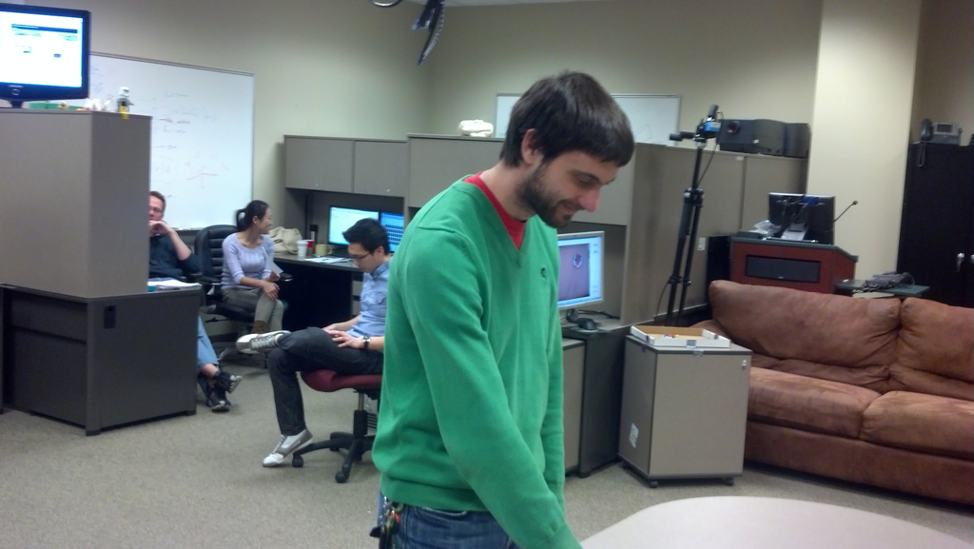
User Studies with Initial Prototype
User Study #1
Cyber Corps lab, two people
Wizard of Oz method
11 suggestions and security flaws regarding personal privacy
User Study #2
Future Computing Lab (FCL) researchers, a group of five people
Wizard of Oz method
14 suggestions
Both focused on technically-savvy users
¹

Slide 9
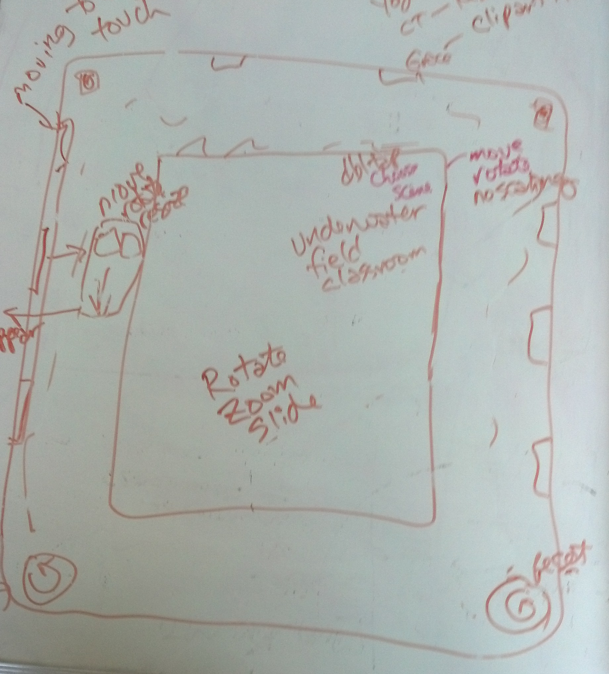
Re-Designed Prototype
ImaginOn’s Story Jar setting
Children-focused
Scene creation
Key Features:
Central moveable workspace with background
ClipArt moveable “menus” around edges
Ability to drag ClipArt onto scene
Rotate, Zoom, Move
Ability to change scenes
Ability to reset scene

Slide 10
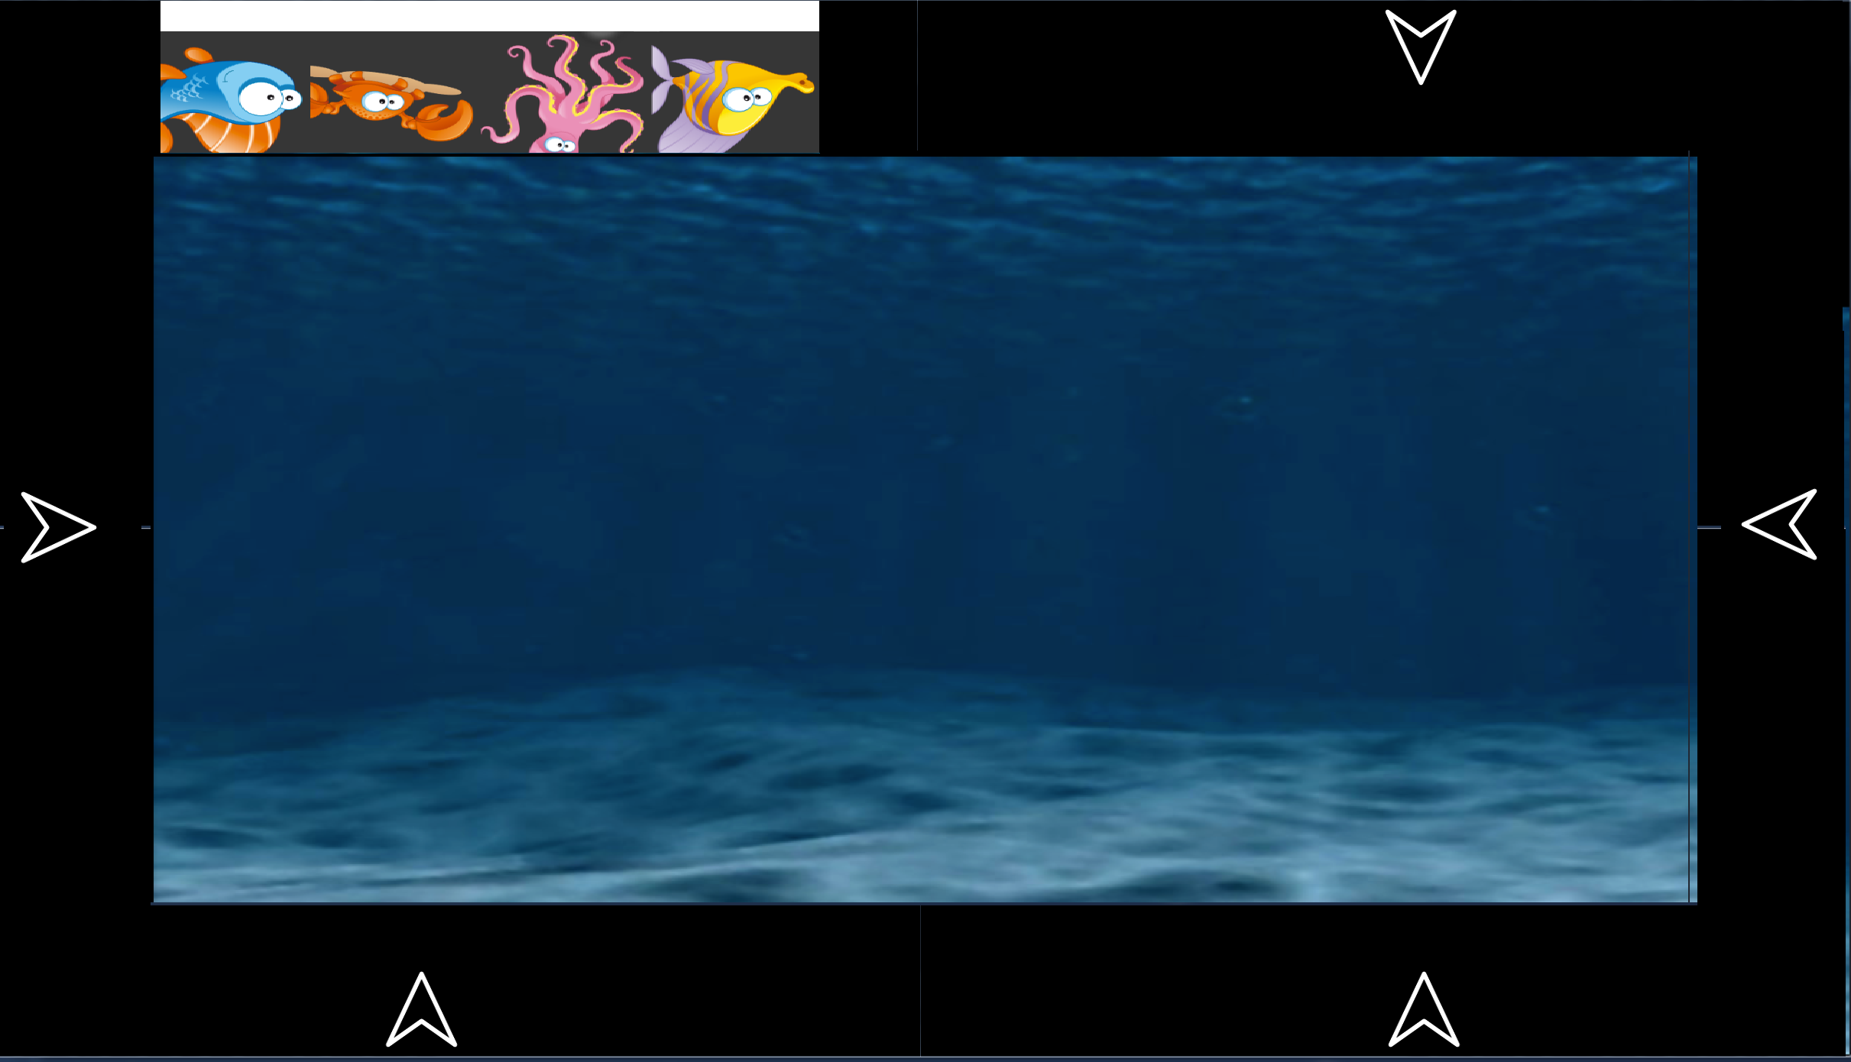
Adjustment of Design
Docking of ClipArt windows
Menu option for background changes
Join button feature
Six ClipArt areas
¹

Slide 11

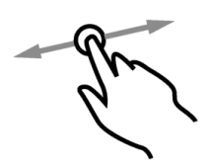
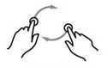

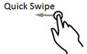
Gesture Usages
Touch
Menu
Join Feature
Drag
Create
Remove
Rotate
Resize
Flick

Slide 12
System Design
Major Objects:
Grid Layout for Screen Placeholders
ClipArt Library Bar
Context Menu for Background area
Drag/Drop Functions
Animations for Join Function

Slide 13
DEMO

Slide 14
Questions?
Notes:
Thank you! – Any questions?

